Slide 1
Wildlife and Humans
Searching for Balance
gConceptualizing our Regional Environment
Master in Environmental Studies
Jason Lim
Eryn Farkas
Jerilyn Walley
Nate Gilman
Ryan Kruse

Slide 2
Key Words
Water quality
Indicator Species
Endangered Species Act
Pollutants
Reproduction
Habitat
Wildlife
Population
Endocrine system
Species Interaction
Global Climate Change

Slide 3
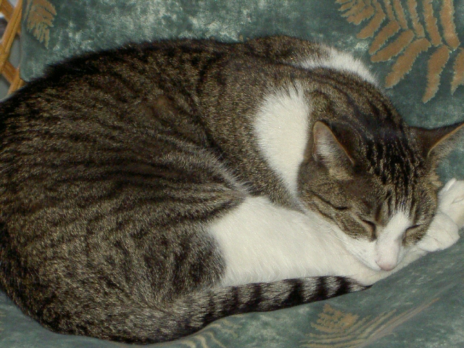
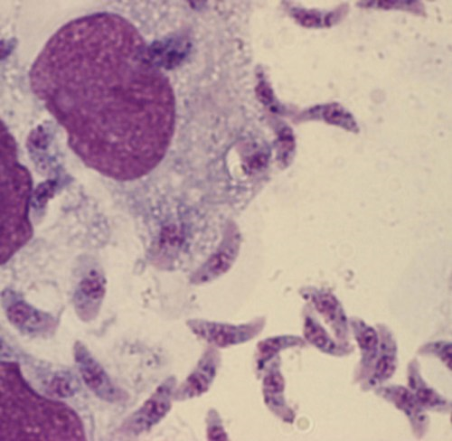
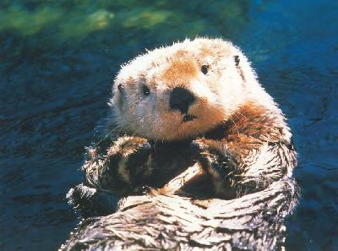
The role of Toxomplasma Gondii in health and population declines in Enhydra Lutris Kenyoni (Northern Sea Otters)

Slide 4
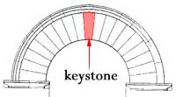
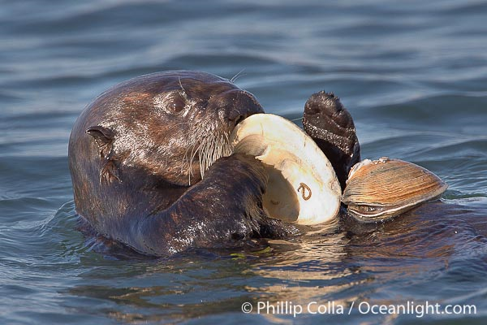
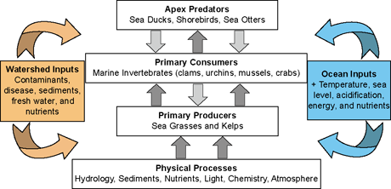

Slide 5
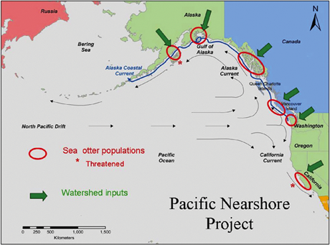

Slide 6
Multiple anthropogenic stressors contribute to malformations and decline of Washington northern leopard frog (Rana pipiens)
Eryn Farkas
Photo: Victor Young

Slide 7
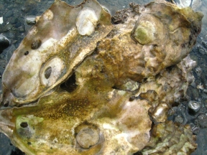
Restoring a Native: The Olympia Oyster Ostrea lurida Carpenter 1864
Jerilyn Walley
Photos: Louie Bloom & Hamma Hamma Oyster Company

Slide 8
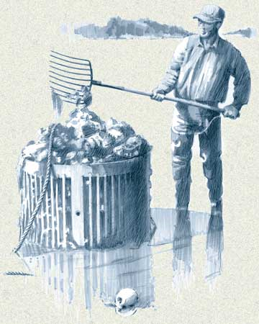
Olympia Oyster
Causes of Decline:
Overharvesting
Introduction of replacement species
Habitat Degradation
Pollution
Point Source
Non-Point Source
Historic Range
Photo: Dr. Kay McGraw
Current Population Range
Photo: Dr. Kay McGraw

Slide 9
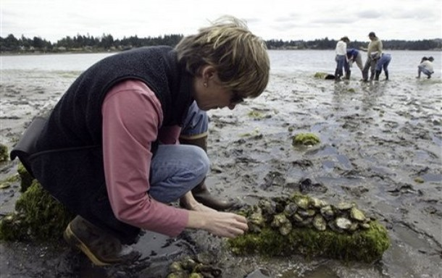
Current Restoration Projects in Washington
Fauntleroy Cove
Fauntleroy Creek
Fidalgo Bay
Judd Creek
Liberty Bay
Willapa Bay
Quartermaster Harbor
Photos: Cooperative Conservation America & Puget Sound Restoration Fund

Slide 10
ARE WE HEADING TOWARD A JELLY WORLD?
Nathaniel Gilman
December 7, 2010
Graduate Conceptualizing Our Regional Environment

Slide 12
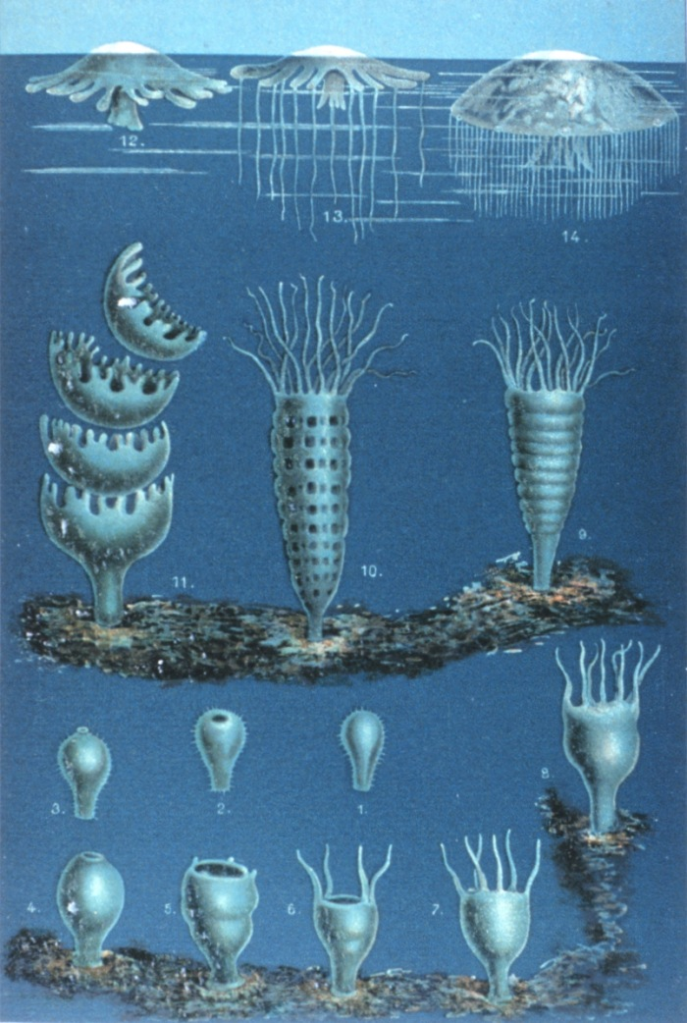

Slide 13
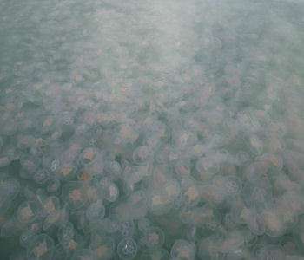

Slide 15
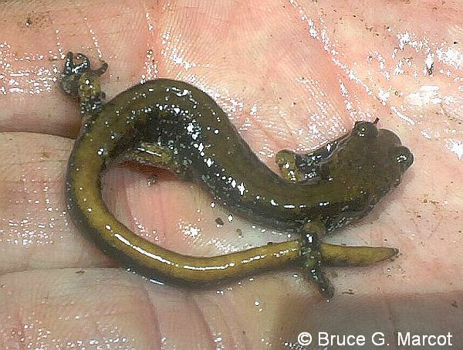
The Van Dyke Salamander: An Indictor Species
By Ryan Kruse
MES
Evergreen State College

Slide 16
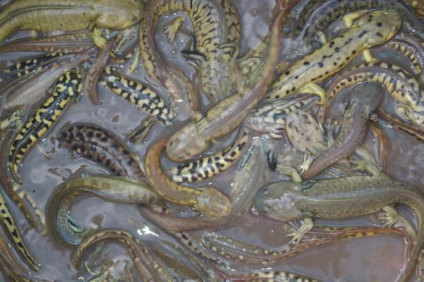
Salamanders, what are they good for?
Frequent forest vertebrate
Mid level predator
Energy cycles

Slide 17
P. vandykei
Rare
Endemic to Washington
Interesting distribution
Specific habitat requirements
Old growth obligate

Slide 19
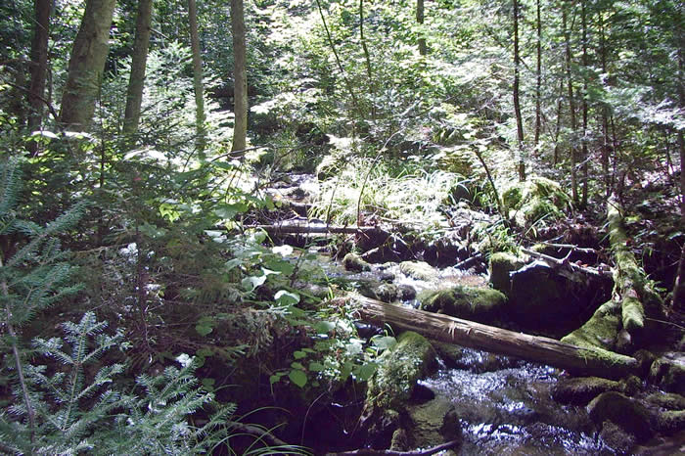
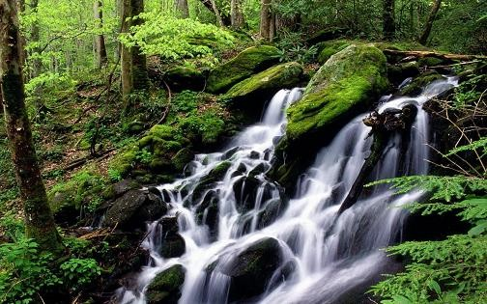
Habitat of P. vandykei
High precipitation
Forest streams and seeps
Water fall splashes
Downed, decayed logs
Cobble

Slide 20
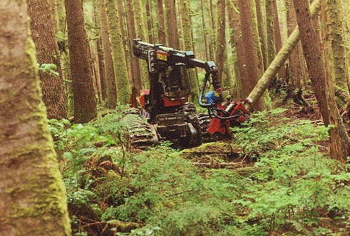
Changes that threaten the Van Dyke’s
Deforestation
Thinning, canopy changes
Lack of DWD
Heat
Stream alterations

Slide 21
Applications
Managed forests may not provide proper habitat for Plethodontids (Aubry, 2000).
Salamander habitat may also be home to other amphibians
Preservation of microhabitat is essential part of forest management
Attempts to protect P. vandykei may be beneficial to other species

Slide 22
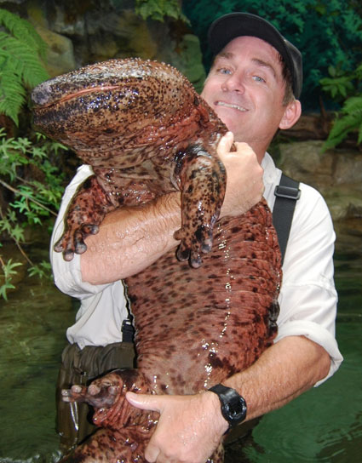
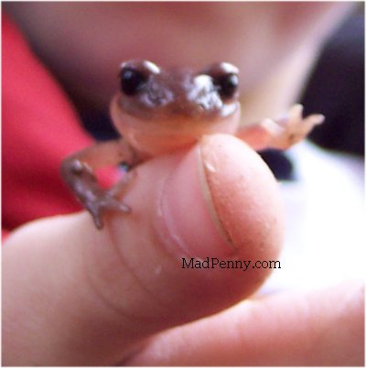
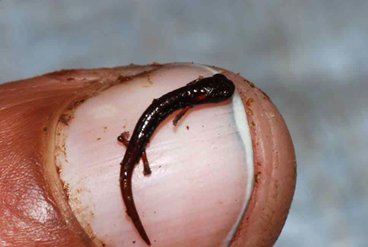
Thanks to:
Department of Fish and Wildlife
Amy McIntyre
Lori Saltzer
Questions?

