Slide 1
Policy and Restoration in Vegetation Management
Allison Smith
Evan Mangold
Scott Stavely
Marissa Whisman
Tim Rogers
Jennie Husby

Slide 2
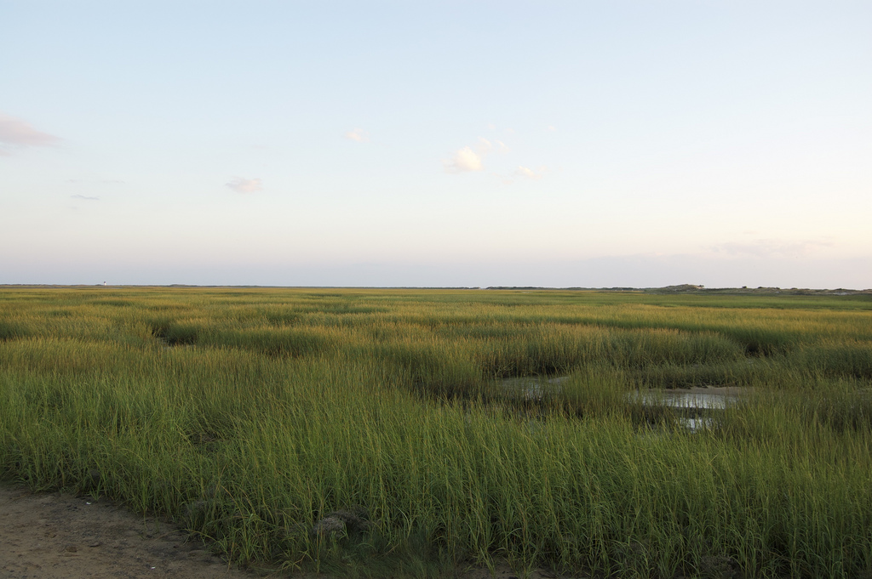
What makes a plant invasive?
Allison Smith
Fall 2010
Notes:
Image: erikorama, http://www.flickr.com/photos/erikorama/4943864958/in/photostream/

Slide 3
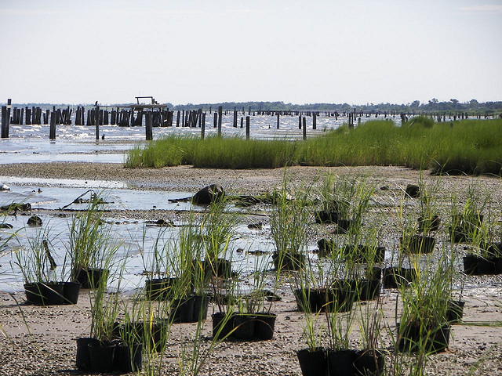
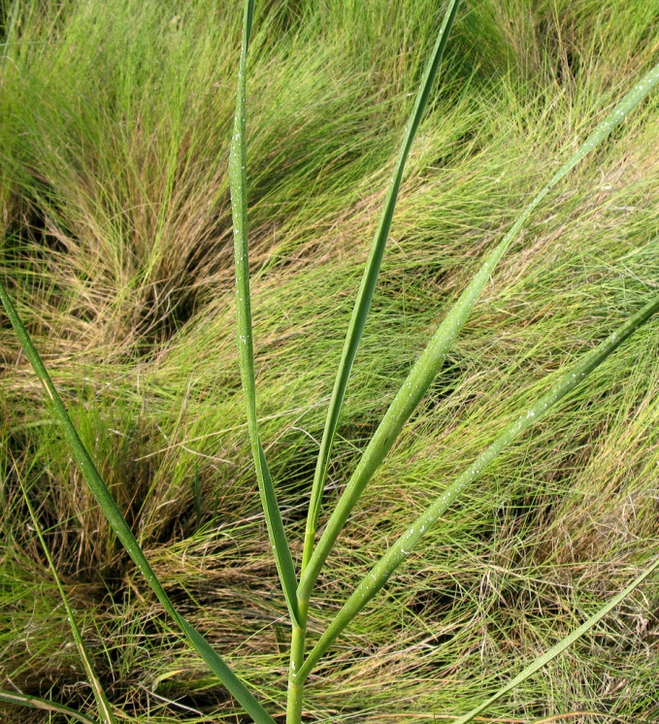
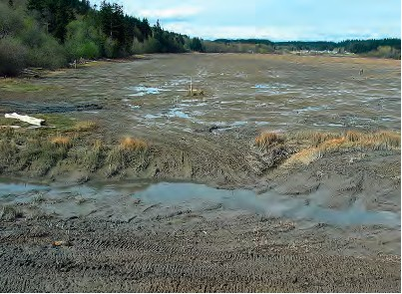
Spartina restoration, Louisiana
Spartina alterniflora and Spartina patens
Spartina eradication, Washington
Notes:
Images: Left - Spartina alterniflora; Sandy Richard. http://www.flickr.com/photos/9428166@N03/2687259862/
Upper right: Restoring spartina in Louisiana. Image by eustatic. http://www.flickr.com/photos/eustatic/1013302092/sizes/o/
Lower right: WA Department of Agriculture: Triangle Cove on Camano Island before major Spartina treatment in 2002
and in the spring of 2007.

Slide 4
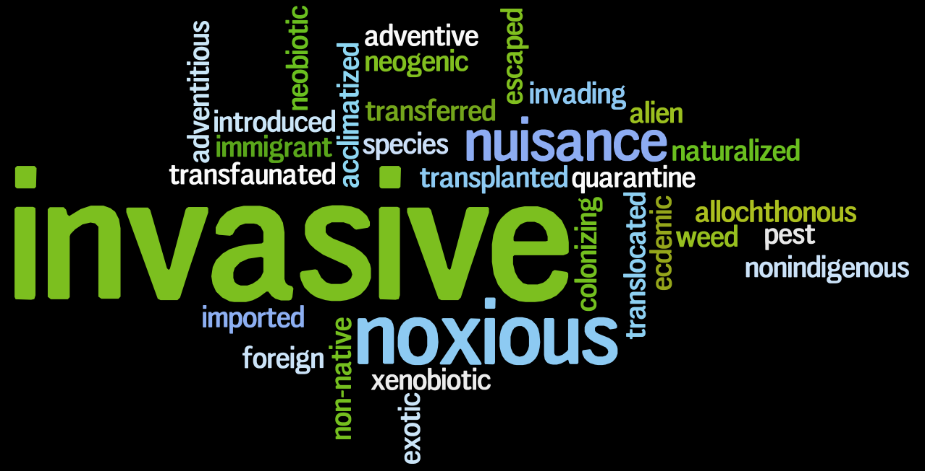
Invasive word cloud
Notes:
http://www.wordle.net/show/wrdl/2855215/InvasivePlantSpecies

Slide 5
Federal Definition of Invasive
Executive Order 13111: “a species that is non-native to the ecosystem under consideration and whose introduction causes or is likely to cause economic or environmental harm or harm to human health.”

Slide 6
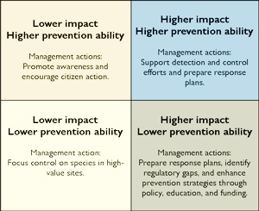
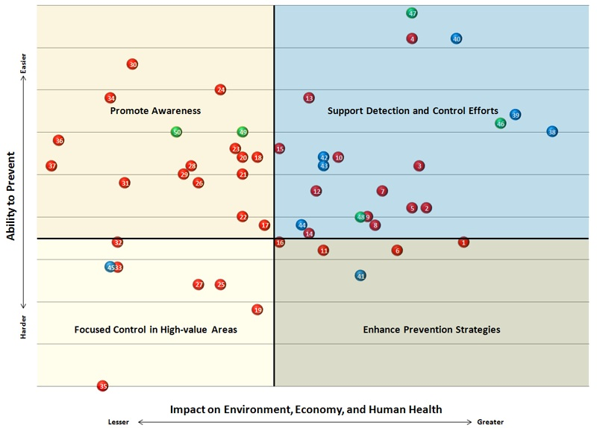
Washington Invasive Species Council
Established in 2006 by SB 5385
Defines invasives as “nonnative organisms that cause economic or environmental harm and are capable of spreading to new areas of the state.”
Prioritizes by impact and by ability to prevent

Slide 7
Will Climate Change Make Us Consider Amnesty for Invasive Plants?

Slide 8
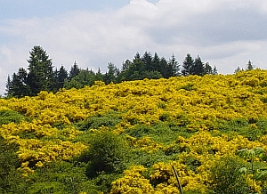
Scotch Broom Removal Methods
Evan Mangold

Slide 9
Quick Facts
Introduced in the 1800’s
Average height of 3-5 feet
Average lifespan of 17 years
Durable seed bank

Slide 10
Why it Should be Removed
Serious threat to native species
Dominates over other plant species
Makes reforestation difficult
Spreads easily

Slide 11
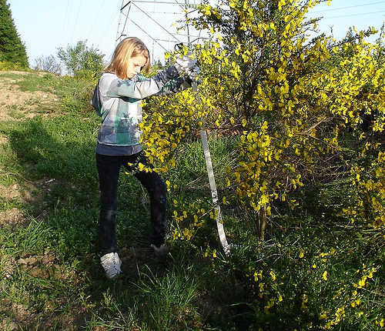
Manual and Mechanical Methods
Pulling
Wrench-removal
Brush-hog removal
Saw cutting

Slide 12
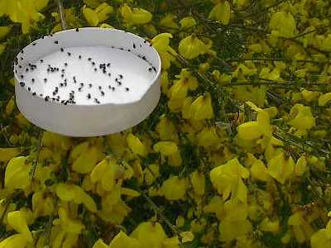
Biological Methods
Stem Miner
Seed Beetle
Broom Twig Moth
Seed Weevil
Grazing

Slide 13
Chemical Methods
Can be the most effective but also the most harmful
Notorious for damaging non-target species
Rely greatly on appropriate timing and application

Slide 14
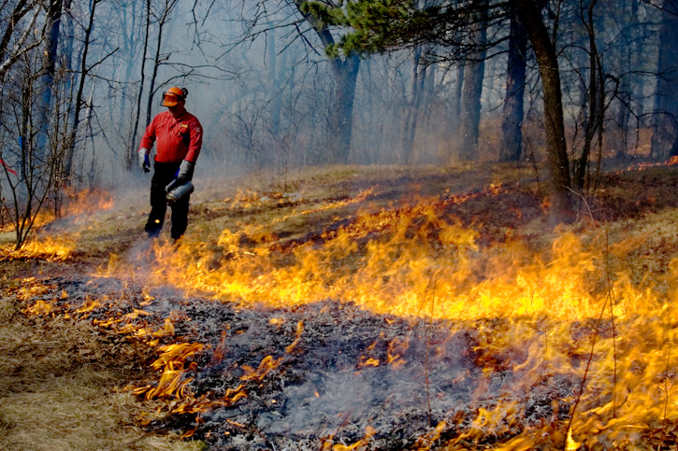
Controlled Burns
Best suited for large patches
Harms non-target species
Difficult to plan

Slide 15
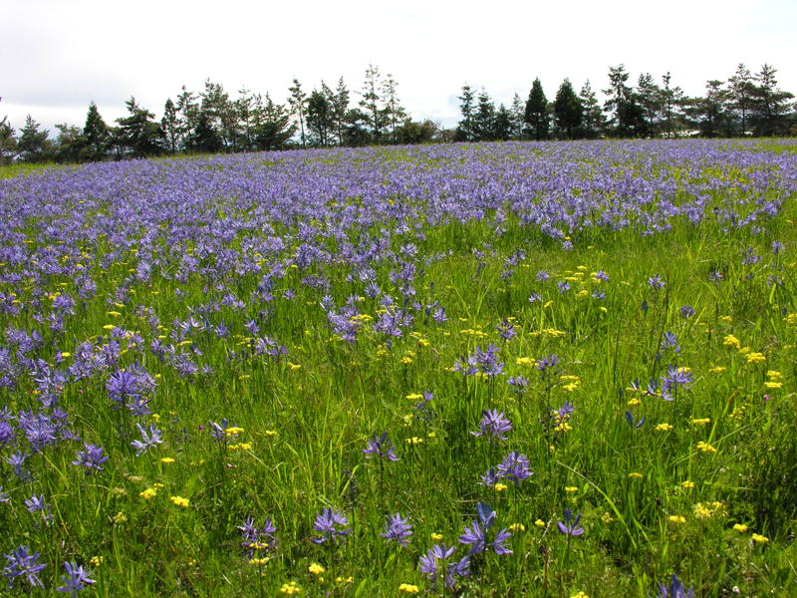
Restoration Applications for Smith Prairie
By Scott Stavely

Slide 16
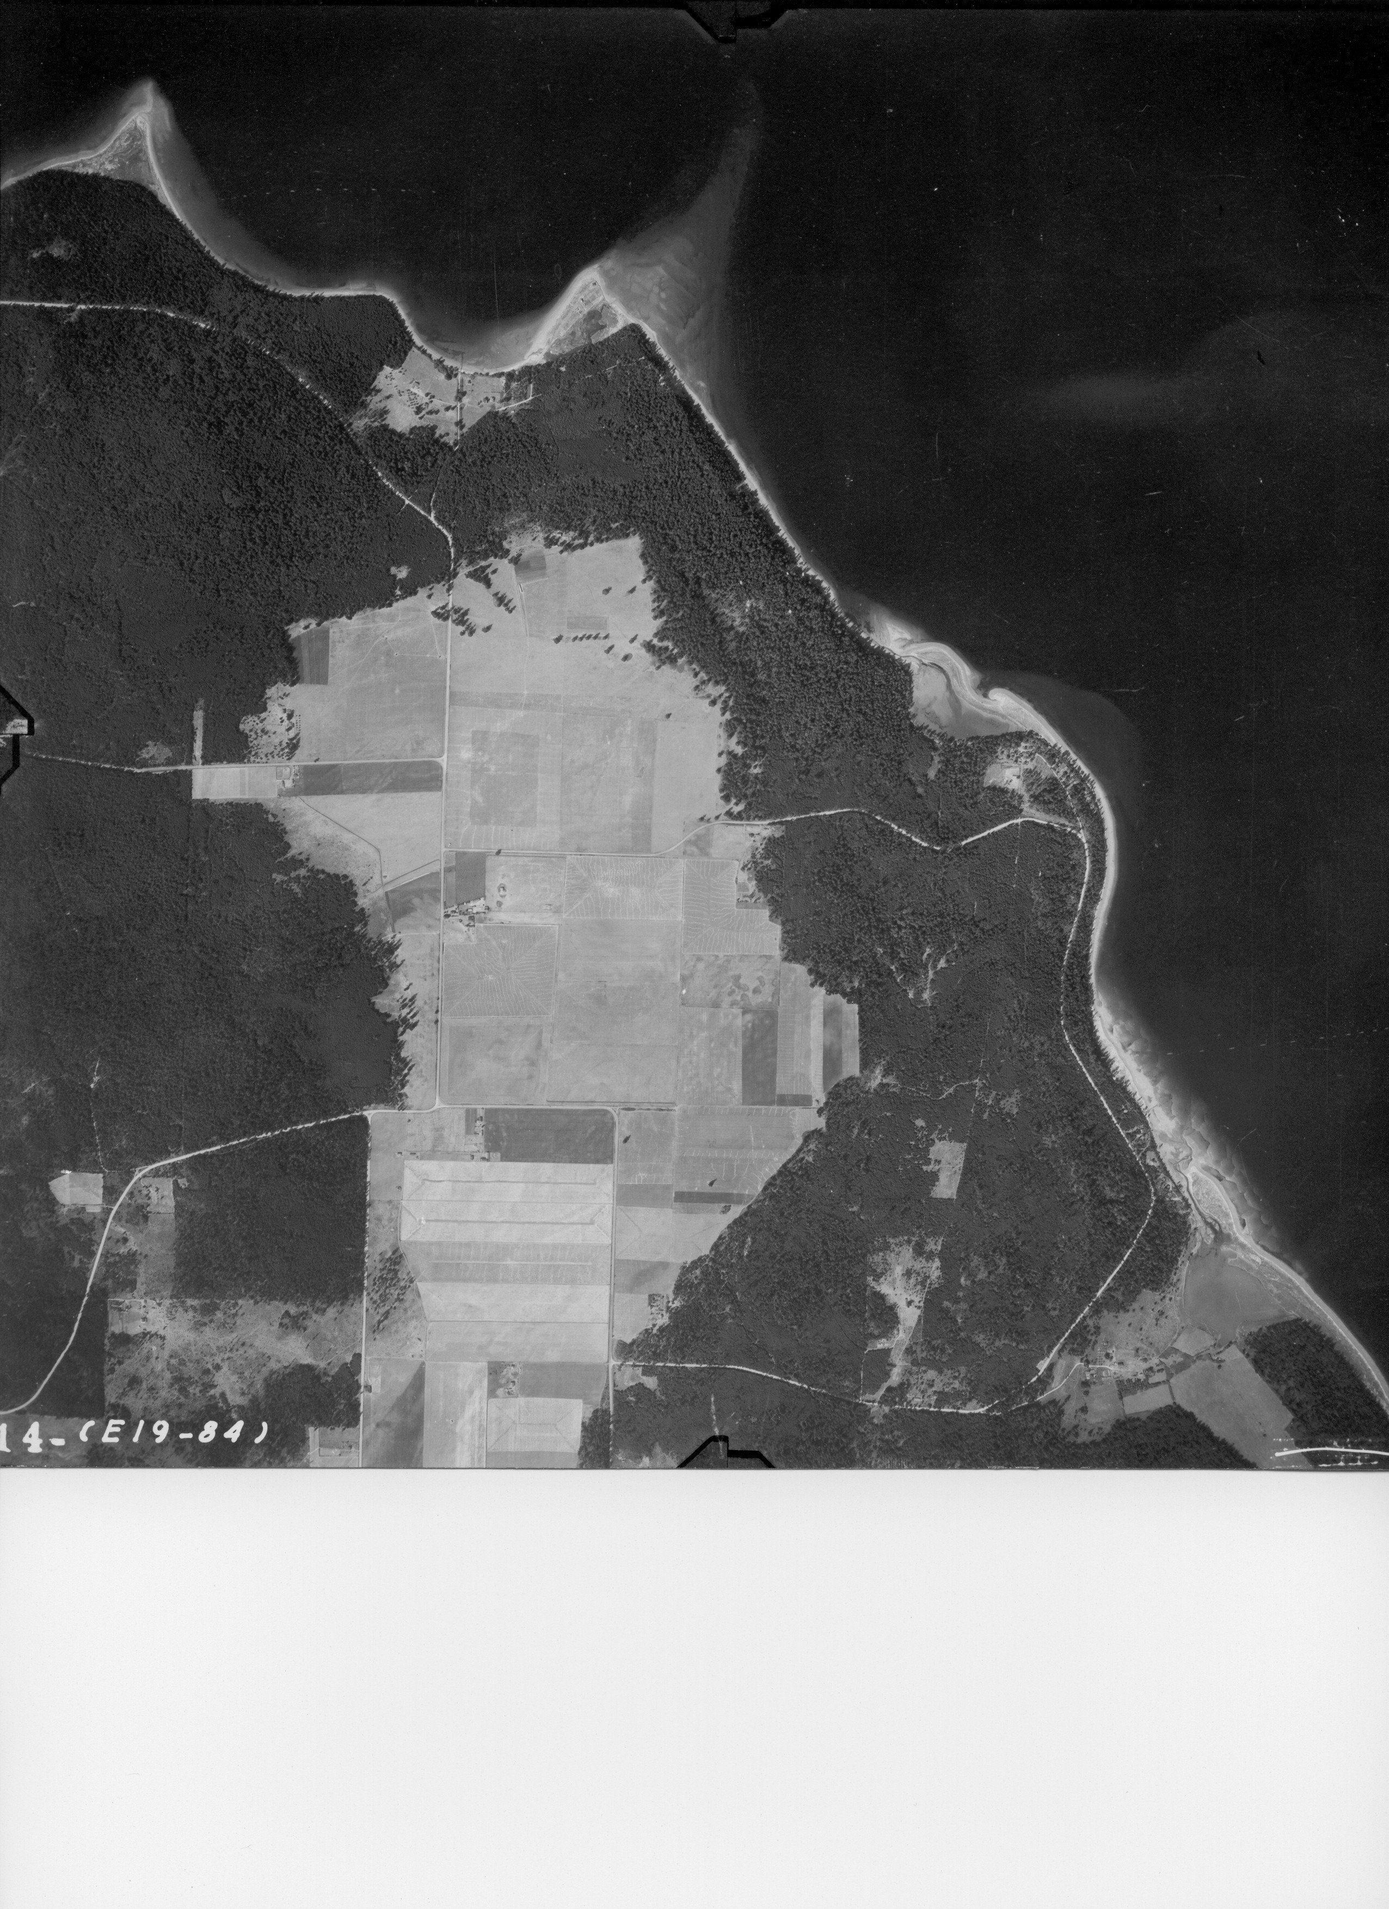
History
Puget Lowland Prairies
Began forming after the Fraser glaciation, 10,000ybp
Outwash soils
Climate shift
Natural burn cycle
Human presence
Burned yearly in the fall
Food and materials
150,000-180,000 acres
Biodiversity
Aquifer Recharge
Smith Prairie
~1000 original acres
Lower Skagit tribe
Farms, NOLAF, PRI

Slide 17
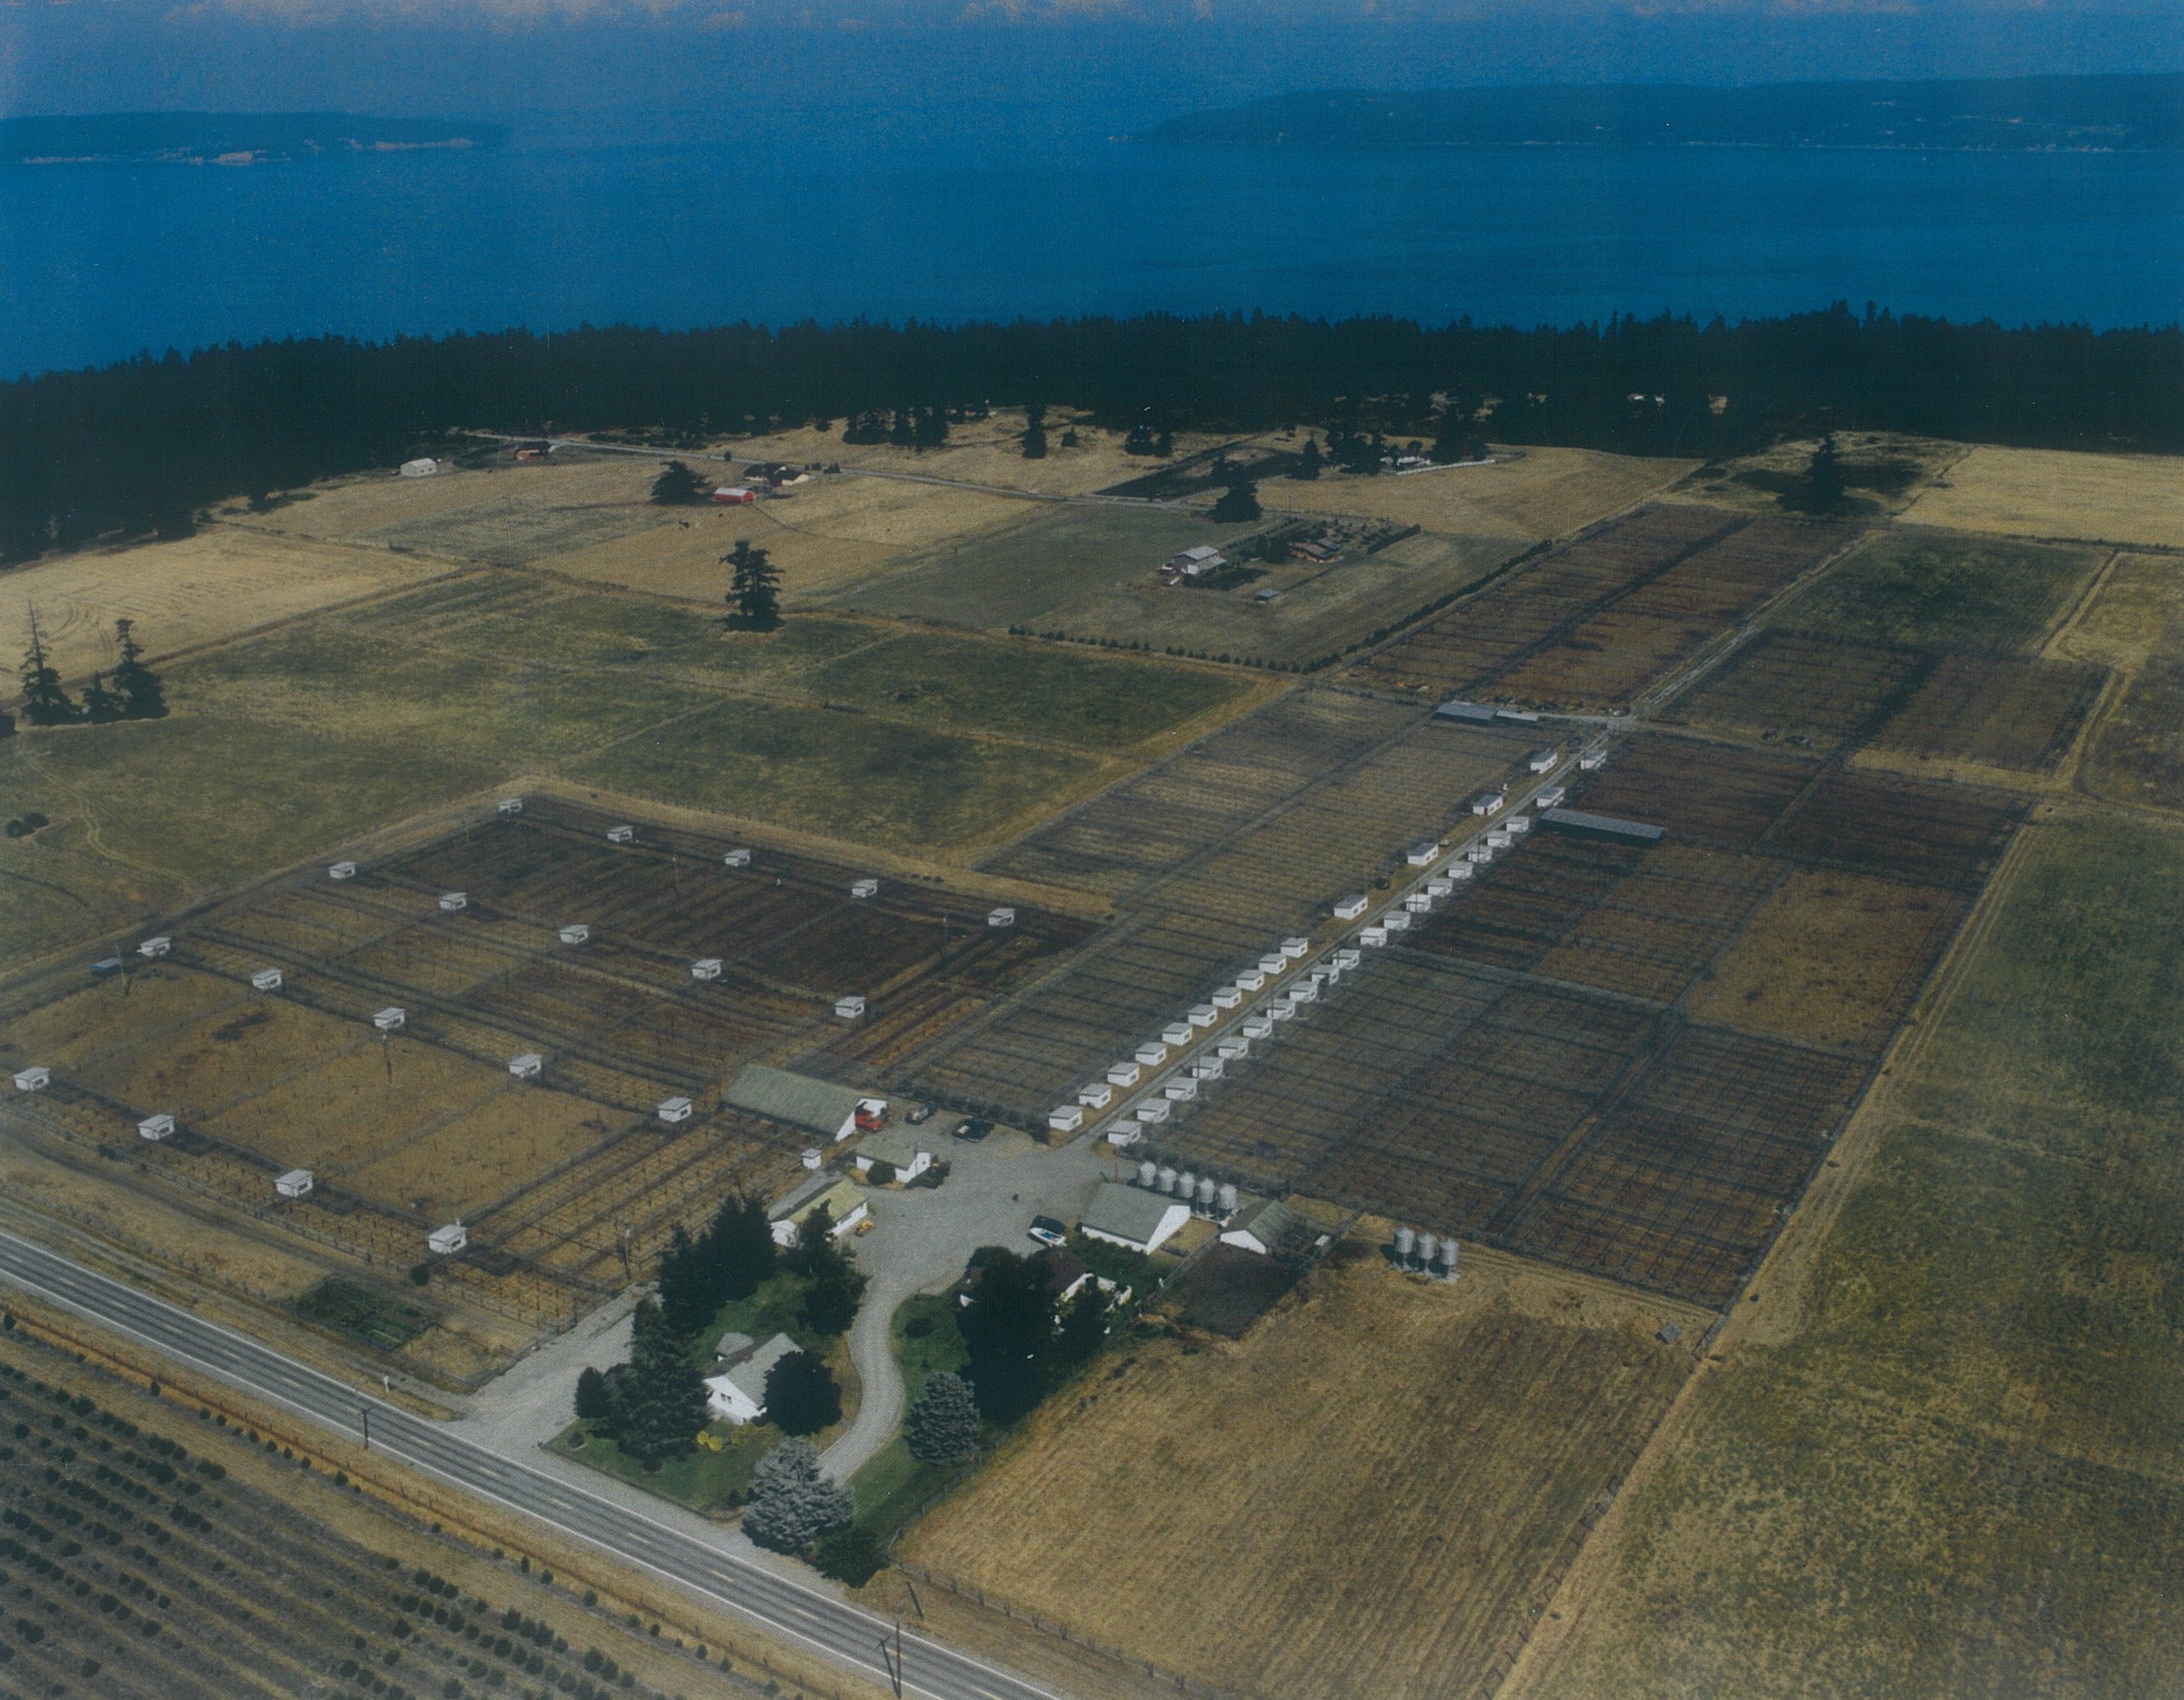

Slide 18
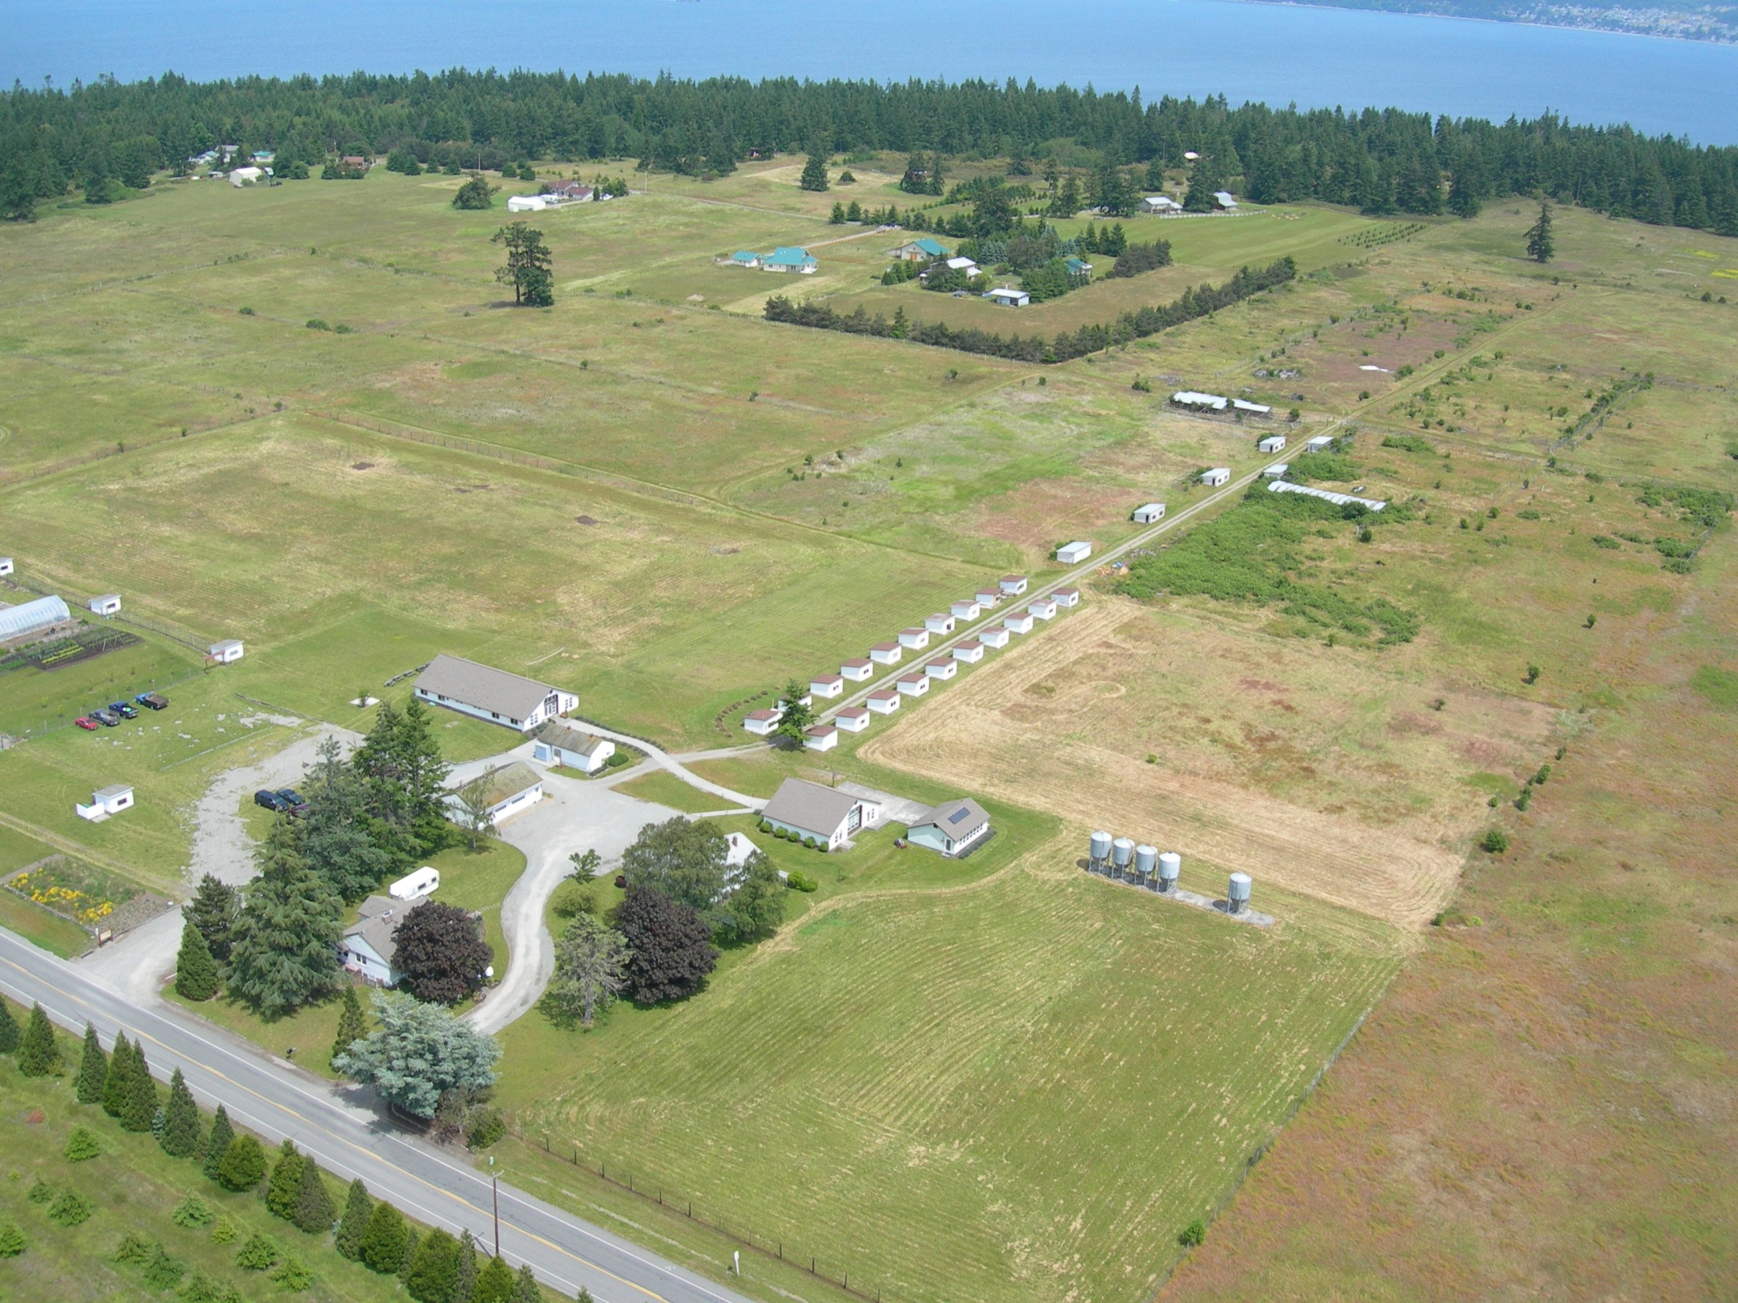

Slide 19
Now what?
How to do a proper restoration?
History – Natural and anthropogenic
Extent, species composition, burn intervals
Actions – Species removal and reintroduction
Strengths and weaknesses
Tools and Techniques – What is available
Cost, scale, effectiveness, appropriateness, time

Slide 20
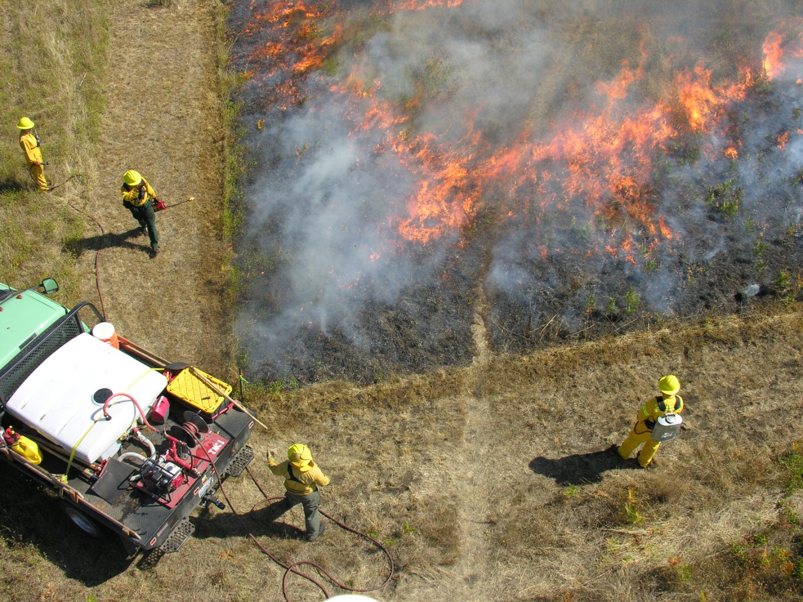
Fire
Most important tool
Original condition
Top kill, duff removal, heat smoke
Quick, few men, inexpensive
Relatively safe

Slide 21
Herbicides
Post-emergent
Broad – large areas of exotics
Narrow spectrum – mixed natives, exotics
Pre-emergent
Seed banks, annuals
Concerns

Slide 22
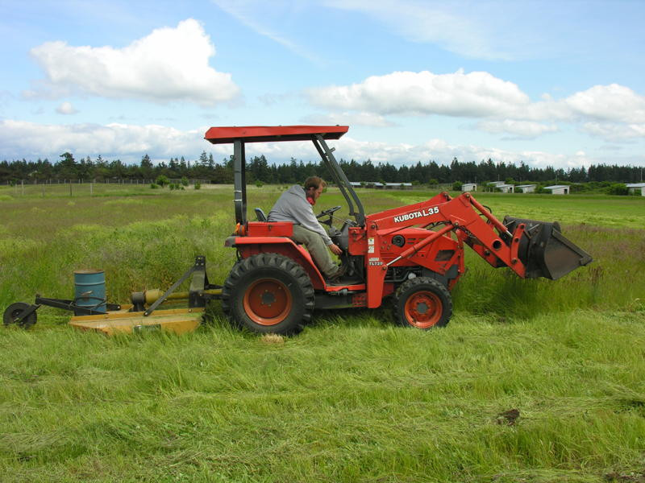
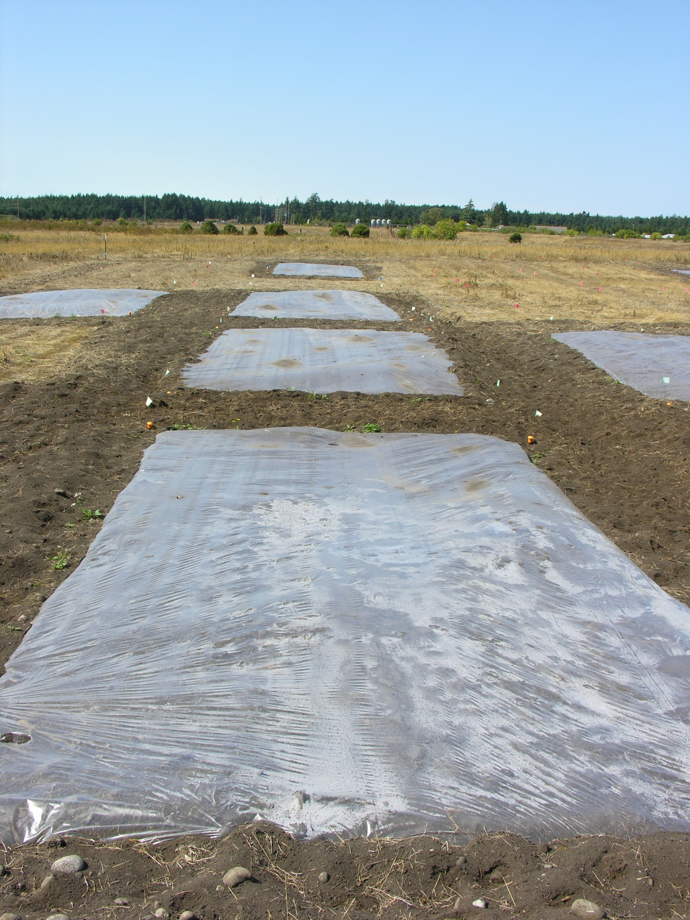
Other methods
Mowing, raking
Plowing
Solarization
Sugar and Charcoal
Manual

Slide 23
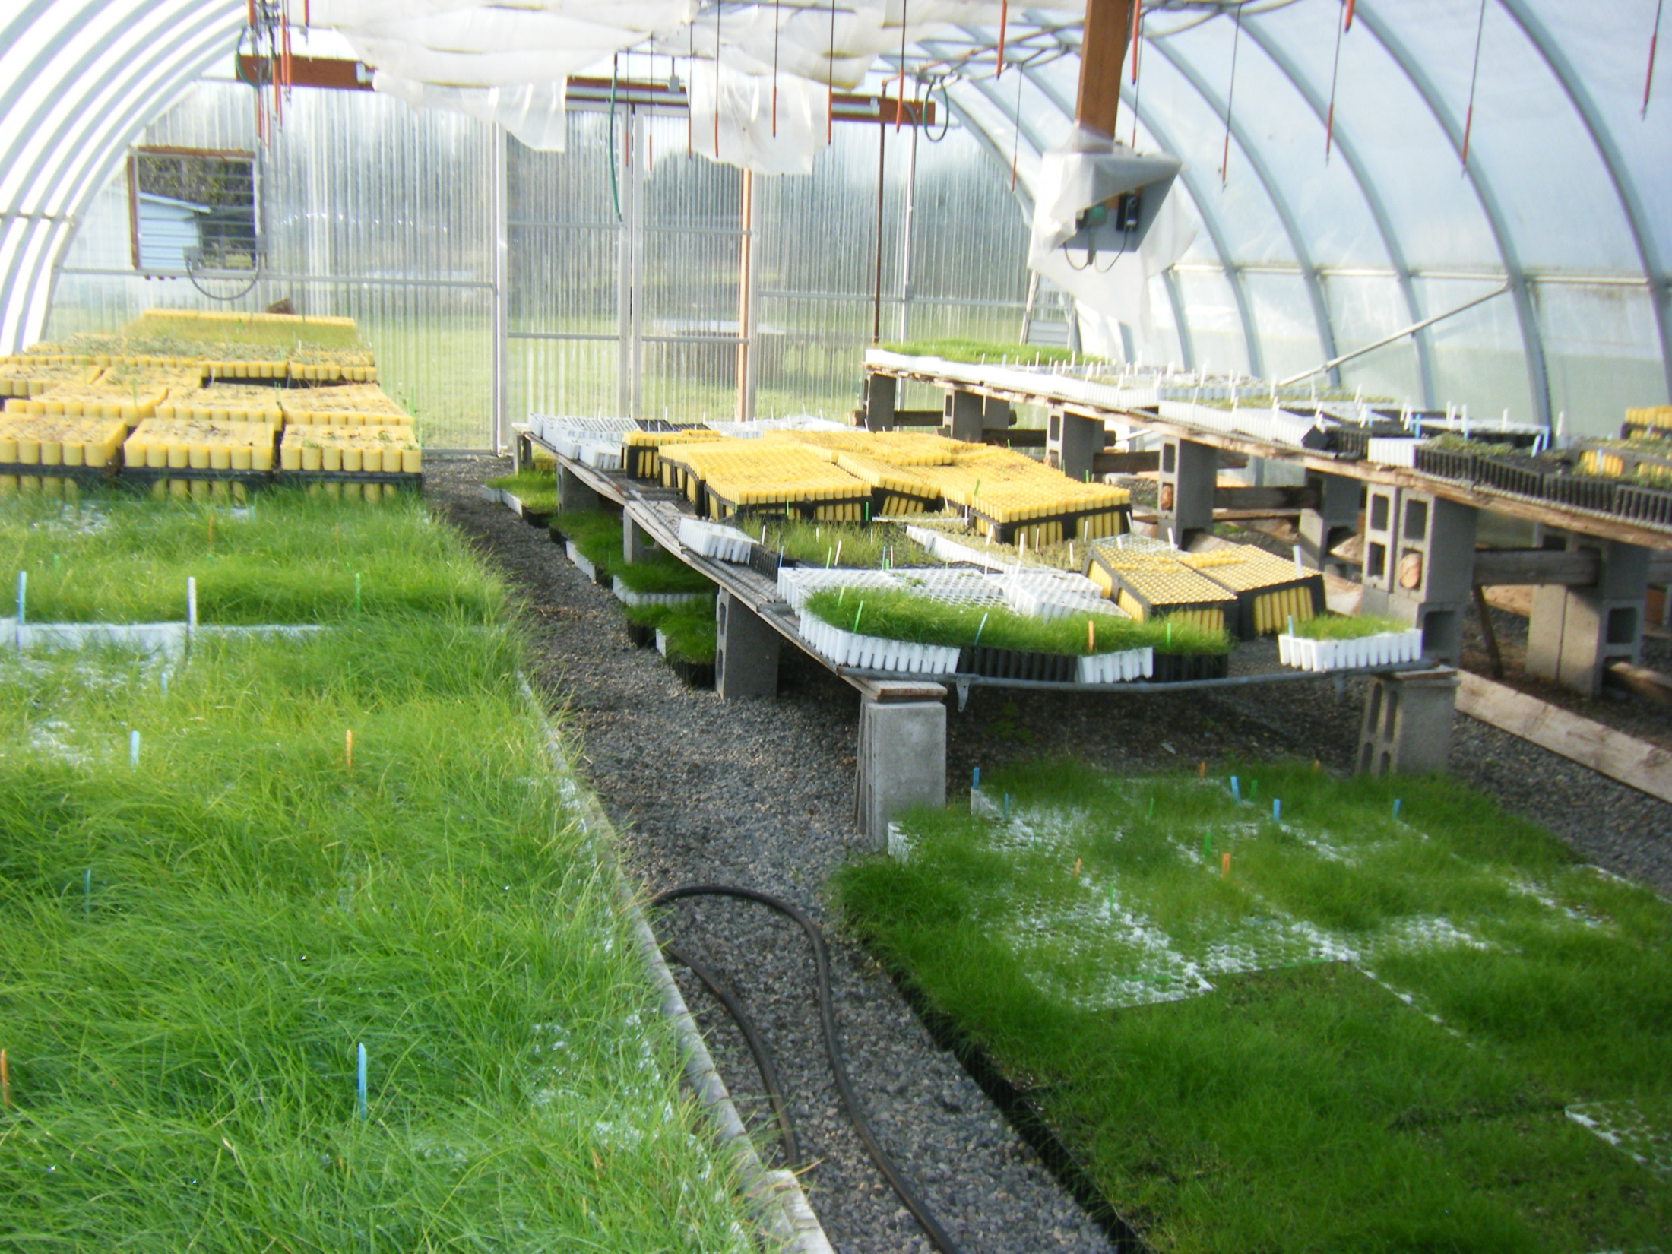
Replanting
Seed cast
Seed drill
Plugs

Slide 24
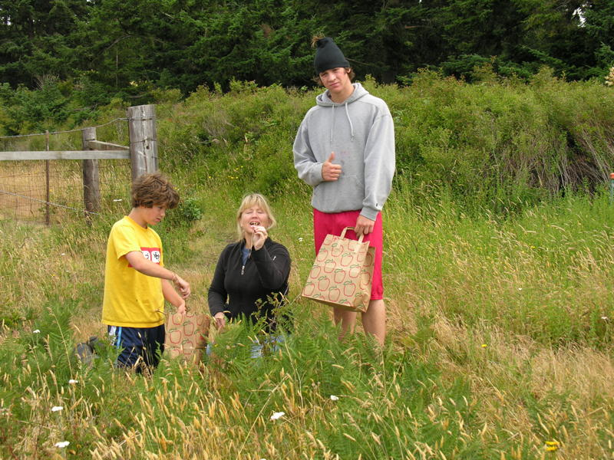
The
Remnant
Seed collection – As much as is ecologically sound
Burn in the fall – Too small
Manual removal – Volunteer work day
Woody specific herbicide – Snowberry, Nootka rose
Sugar and Charcoal – Remove excess nitrogen

Slide 25
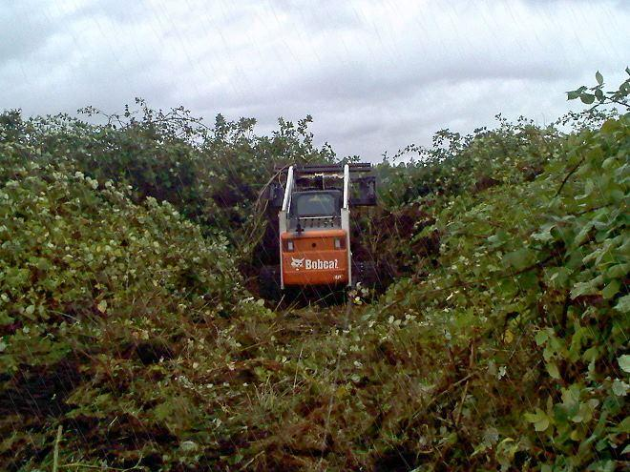
The
Rest
Burn blocks of 15-20 acres burned in the spring every year.
Invasive control – Blackberry, thistle, burl chervil, mustard, salsify
Solarization – random placement of plots in burn blocks each year
Seed cast with predator exclusion

Slide 26

Breaking Ground In Riparian Buffer Restoration and Its Role in Nitrate Removal
By Marisa Whisman
Nitrate (NO₃) is the most common groundwater contaminant in the U.S., and one of the most common nonpoint sources of river pollution
Concentrations > 10 mg per liter can be harmful or fatal to humans and wildlife
Riparian buffers can serve two functions to nitrate reduce nitrate pollution:
Uptake for nutrient use – intercept runoff before it reaches the water
Remove nitrates from ground and subsurface water through denitrification (Convert NO₃ → N₂O, NO, or N₂ gas through root/microbial interaction)
Woody plants more effective at nitrate removal than forbs or grasses because they supply more carbon to denitrifying microbes
Breaking Ground In Riparian Buffer Restoration and Its Role in Nitrate Removal
By Marisa Whisman
Nitrate (NO₃) is the most common groundwater contaminant in the U.S., and one of the most common nonpoint sources of river pollution
Concentrations > 10 mg per liter can be harmful or fatal to humans and wildlife
Riparian buffers can serve two functions to nitrate reduce nitrate pollution:
Uptake for nutrient use – intercept runoff before it reaches the water
Remove nitrates from ground and subsurface water through denitrification (Convert NO₃ → N₂O, NO, or N₂ gas through root/microbial interaction)
Woody plants more effective at nitrate removal than forbs or grasses because they supply more carbon to denitrifying microbes

Slide 27
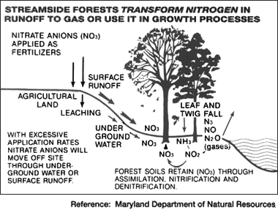
Flow pathway of nitrate runoff: Surface flow, subsurface flow, plant uptake and conversion to gas

Slide 28
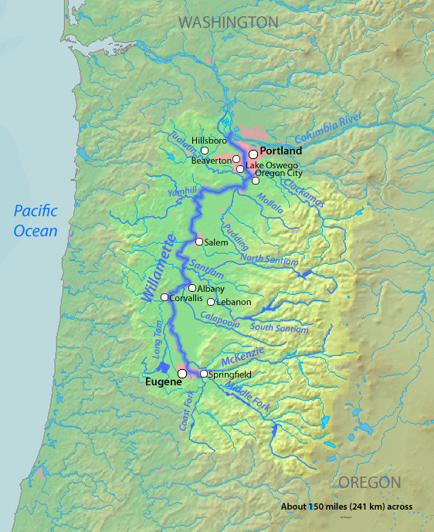
The Calapooia River is one of the major tributaries of the Willamette River, Oregon

Slide 29
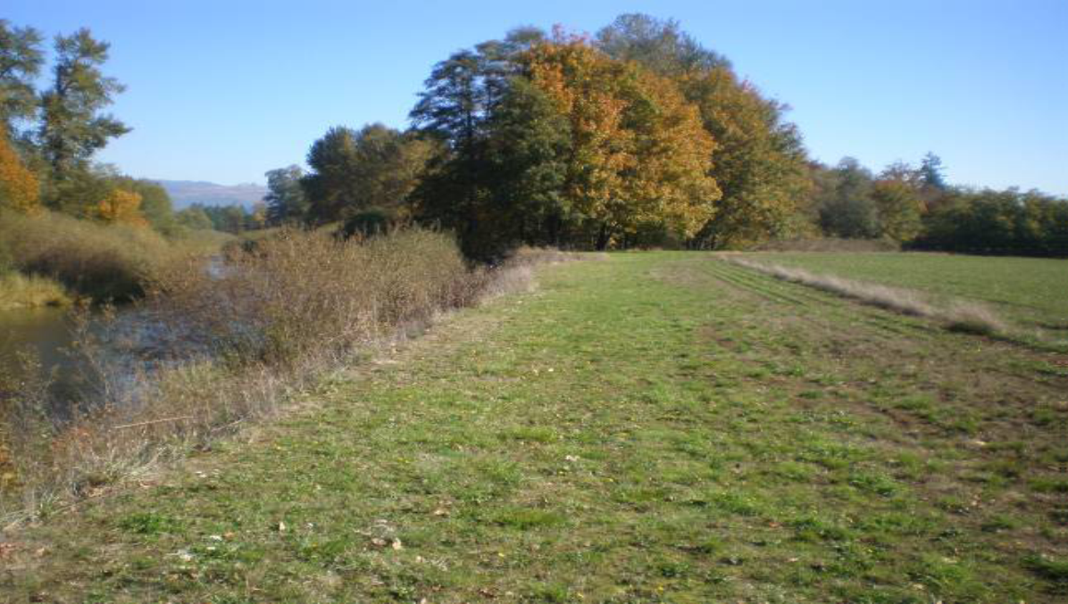
Grass seed field with thin riparian riparian buffer, Calapooia River

Slide 30
How can conifers help riparian ecosystems adapt to climate change?

Slide 31
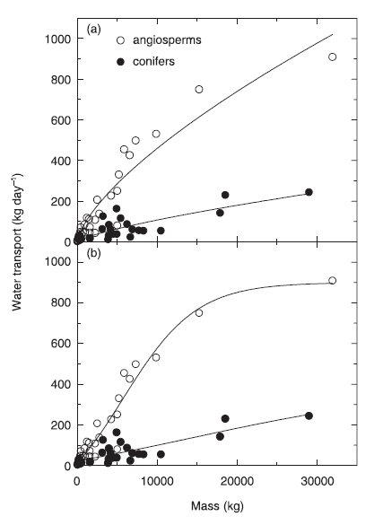
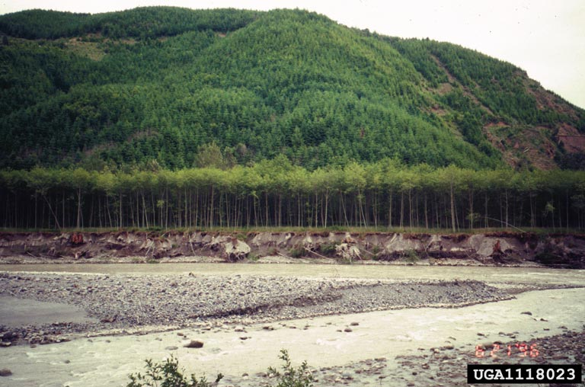
Water Used by Trees
Photo: Brian Lockhart

Slide 32
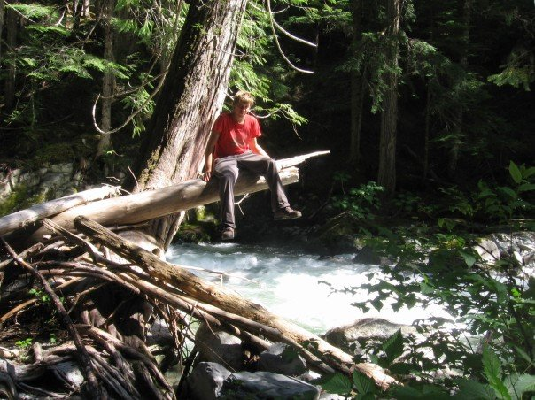
Photo: Tim Rogers

Slide 33
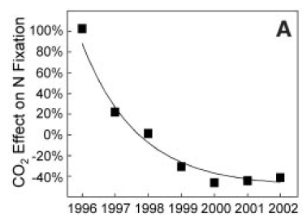
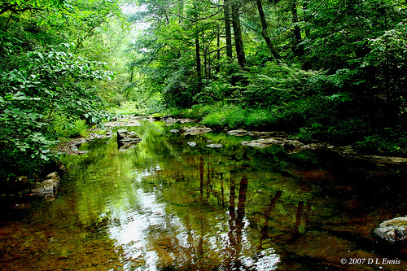
Effects of CO2 Enrichment on Nitrogen Fixation
Graph: Bruce Hungate et al., 2004
Photo: D. L. Ennis

Slide 34
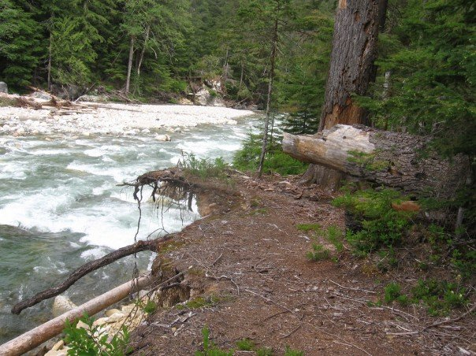
Photo: Tim Rogers

Slide 35
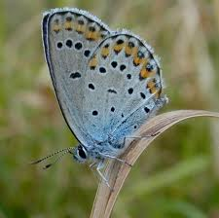
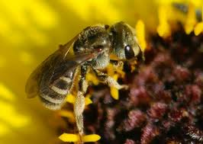
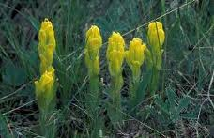
Management of Pollinators
in the Puget Lowland Prairies
Jennie Husby
http://www.google.com/imghp?hl=en&tab=wi

Slide 36
Causes of Disruption to Pollinator Habitat:
Fragmentation
Chemical Pesticides and Herbicides
Non-native Species

Slide 37



















Ranchers
Local Farmers
Private Citizens
http://www.google.com/imghp?hl=en&tab=wi

Slide 38
Political Ecology =
dealing with environmental issues in
the context of the largest system

Slide 39
Questions for the Panel?

